Slide 1
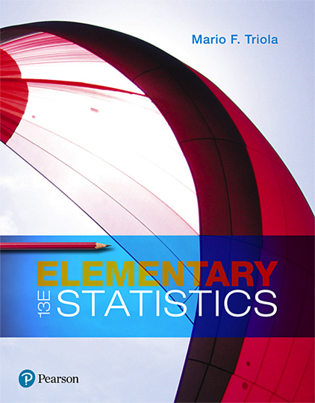
Elementary Statistics
Thirteenth Edition
Chapter 7
Estimating Parameters and Determining Sample Sizes
Copyright © 2018, 2014, 2012 Pearson Education, Inc. All Rights Reserved

Slide 2
Estimating Parameters and Determining Sample Sizes
7-1 Estimating a Population Proportion
7-2 Estimating a Population Mean
7-3 Estimating a Population Standard Deviation or Variance
7-4 Bootstrapping: Using Technology for Estimates

Slide 3
Key Concept
This section presents methods for using a sample standard deviation s (or a sample variance s²) to estimate the value of the corresponding population standard deviation σ (or population variance σ²). Here are the main concepts:
Point Estimate: The sample variance s² is the best point estimate of the population variance σ².
Confidence Interval: When constructing a confidence interval estimate of a population standard deviation, we construct the confidence interval using the χ² distribution.

Slide 4
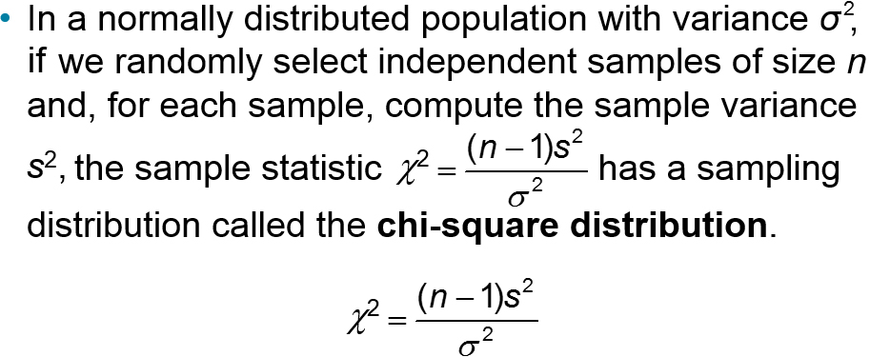
Chi-Square Distribution (1 of 6)
Key points about the χ² (chi-square or chi-squared) distribution:

Slide 5
Chi-Square Distribution (2 of 6)
Critical Values of χ² We denote a right-tailed critical value by χ_{R}² and we denote a left-tailed critical value by χ_{L}². Those critical values can be found by using technology or Table A-4, and they require that we first determine a value for the number of degrees of freedom.
Degrees of Freedom For the methods of this section, the number of degrees of freedom is the sample size minus 1.
Degrees of freedom: df = n − 1

Slide 6
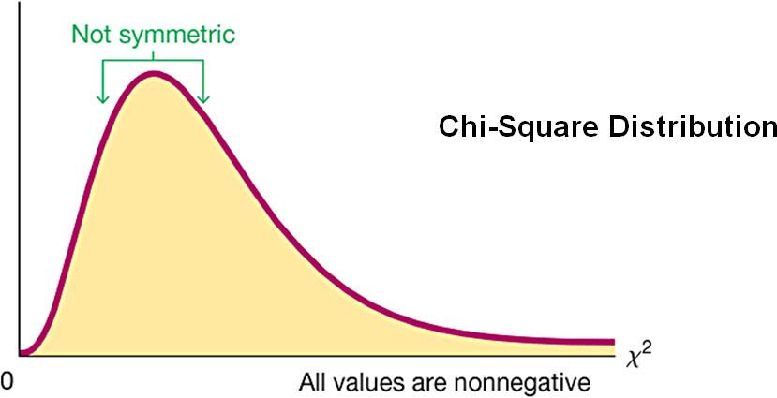
Chi-Square Distribution (3 of 6)
The chi-square distribution is skewed to the right, unlike the normal and Student t distributions.

Slide 7
Chi-Square Distribution (4 of 6)
The values of chi-square can be zero or positive, but they cannot be negative.

Slide 8
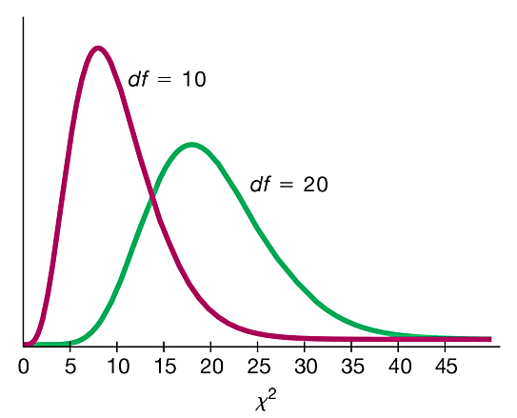
Chi-Square Distribution (5 of 6)
The chi-square distribution is different for each number of degrees of freedom. As the number of degrees of freedom increases, the chi-square distribution approaches a normal distribution.
Chi-Square Distribution for df = 10 and df = 20

Slide 9
Chi-Square Distribution (6 of 6)
Because the chi-square distribution is not symmetric, a confidence interval estimate of σ² does not fit a format of s² − E < σ² < s² + E, so we must do separate calculations for the upper and lower confidence interval limits. If using Table A-4 for finding critical values, note the following design feature of that table:
In Table A-4, each critical value of χ² in the body of the table corresponds to an area given in the top row of the table, and each area in that top row is a cumulative area to the right of the critical value.

Slide 10
Example: Finding Critical Value of χ² (1 of 4)
A simple random sample of 22 IQ scores is obtained. Construction of a confidence interval for the population standard deviation s requires the left and right critical values of χ² corresponding to a confidence level of 95% and a sample size of n = 22. Find χ²_{L} (the critical value of X² separating an area of 0.025 in the left tail), and find χ²_{R} (the critical value of X² separating an area of 0.025 in the right tail).

Slide 11
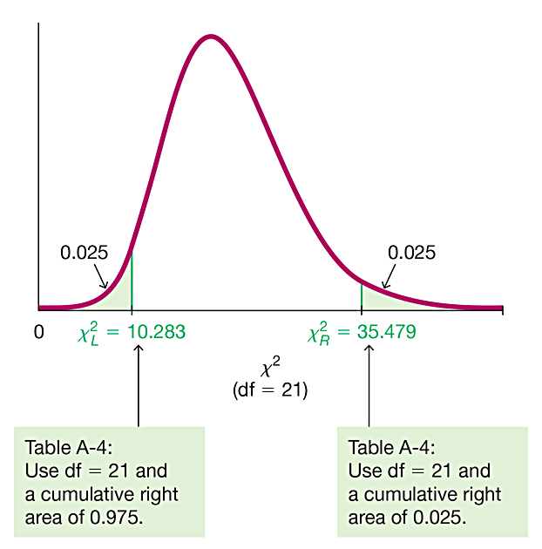
Example: Finding Critical Value of χ² (2 of 4)
Solution
With a sample size of n = 22, the number of degrees of freedom is df = n − 1 = 21.

Slide 12
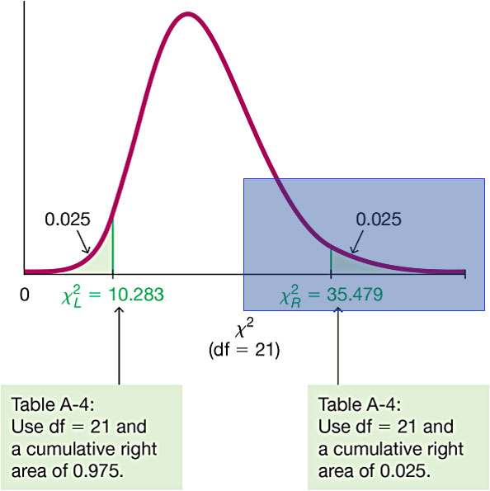
Example: Finding Critical Value of χ² (3 of 4)
Solution
χ²_{R} = 35.479
The critical value to the right is obtained from Table A-4 in a straightforward manner by locating 21 in the degrees-of-freedom column at the left and 0.025 across the top row.

Slide 13
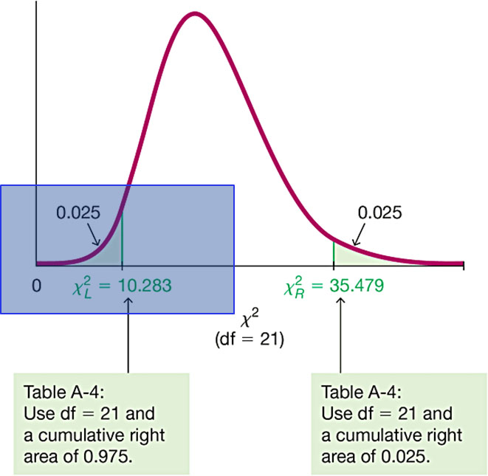
Example: Finding Critical Value of χ² (4 of 4)
Solution
χ²_{L} = 10.283
But, we must locate 0.975 (or 1 − 0.025) across the top row because the values in the top row are always areas to the right of the critical value. The total area to the right of is 0.975.

Slide 14
Confidence Interval for Estimating a Population Standard Deviation or Variance: Objective
Construct a confidence interval estimate of a population standard deviation or variance.

Slide 15
Confidence Interval for Estimating a Population Standard Deviation or Variance: Notation
σ = population standard deviation
σ² = population variance
s = sample standard deviation
s² = sample variance
n = number of sample values
E = margin of error χ²
χ²_{L} = left-tailed critical value of χ²
χ²_{R} = left-tailed critical value of χ²

Slide 16
Confidence Interval for Estimating a Population Standard Deviation or Variance: Requirements
The sample is a simple random sample.
The population must have normally distributed values. The requirement of a normal distribution is much stricter here than in earlier sections, so large departures from normal distributions can result in large errors.

Slide 17
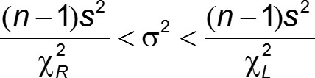
Confidence Interval for Estimating a Population Standard Deviation or Variance: Confidence Interval for the Population Variance σ²

Slide 18
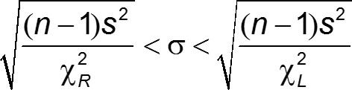
Confidence Interval for Estimating a Population Standard Deviation or Variance: Confidence Interval for the Population Standard Deviation σ

Slide 19
Confidence Interval for Estimating a Population Standard Deviation or Variance: Round-Off Rule
​​Original Data: When using the original set of data values, round the confidence interval limits to one more decimal place than is used for the original data.
​​​Summary Statistics: When using the summary statistics (n, s), round the confidence interval limits to the same number of decimal places used for the sample standard deviation.

Slide 20

Procedure for Constructing a Confidence Interval for σ or σ² (1 of 2)
Verify that the two requirements are satisfied.
Using n − 1 degrees of freedom, find the critical values χ²_{R} and χ²_{L} that correspond to the desired confidence level.
To get a confidence interval estimate of σ², use the following:

Slide 21
Procedure for Constructing a Confidence Interval for σ or σ² (2 of 2)
To get a confidence interval estimate of σ, take the square root of each component of the above confidence interval.
Round the confidence interval limits using the round-off rule.

Slide 22
Using Confidence Intervals for Comparisons or Hypothesis Tests
Comparisons Confidence intervals can be used informally to compare the variation in different data sets, but the overlapping of confidence intervals should not be used for making formal and final conclusions about equality of variances or standard deviations.

Slide 23
Example: Confidence Interval for Estimating σ of IQ Scores (1 of 6)
Data Set 7 “IQ and Lead” in Appendix B lists IQ scores for subjects in three different lead exposure groups. The 22 full IQ scores for the group with medium exposure to lead (Group 2) have a standard deviation of 14.29263. Consider the sample to be a simple random sample and construct a 95% confidence interval estimate of σ, the standard deviation of the population from which the sample was obtained.

Slide 24
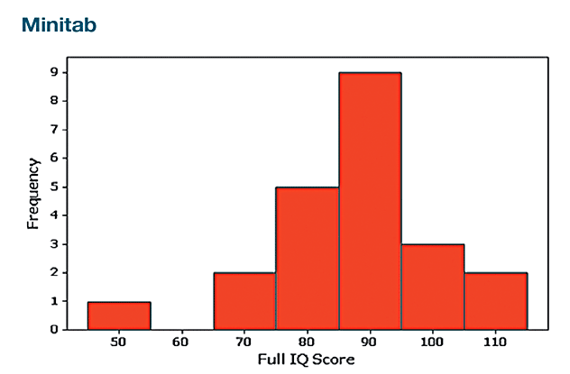
Example: Confidence Interval for Estimating σ of IQ Scores (2 of 6)
Solution
Requirement Check
Step 1: Check requirements. (1) The sample can be treated as a simple random sample.
(2) The accompanying histogram has a shape very close to the bell shape of a normal distribution.

Slide 25
Example: Confidence Interval for Estimating σ of IQ Scores (3 of 6)
Solution
Step 2: If using Table A-4, we use the sample size of n = 22 to find degrees of freedom: df = n − 1 = 21. Refer to the row corresponding to 21 degrees of freedom, and refer to the columns with areas of 0.975 and 0.025. (For a 95% CI, we divide α = 0.05 equally between the two tails of the chi-square distribution, and we refer to the values of 0.975 and 0.025 across the top row.)
The critical values are χ²_{L} = 10.283 and χ²_{R} = 35.479.

Slide 26
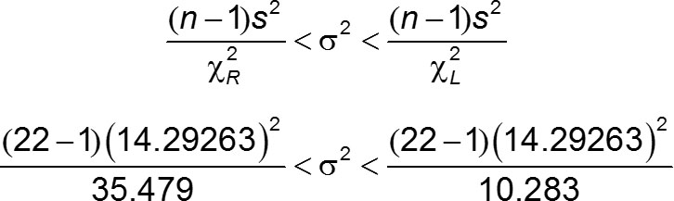
Example: Confidence Interval for Estimating σ of IQ Scores (4 of 6)
Solution
Step 3:Using the critical values of 10.283 and 35.479, the sample standard deviation of s = 14.29263 and the sample size of n = 22, we construct the 95% confidence interval by evaluating the following:

Slide 27
Example: Confidence Interval for Estimating σ of IQ Scores (5 of 6)
Solution
Step 4: Evaluating the expression results in
120.9 < σ² < 417.2.
Finding the square root of each part (before rounding), then rounding to one decimal place, yields this 95% confidence interval estimate of the population standard deviation: 11.0 < σ < 20.4.

Slide 28
Example: Confidence Interval for Estimating σ of IQ Scores (6 of 6)
Interpretation
Based on this result, we have 95% confidence that the limits of 11.0 and 20.4 contain the true value of s. The confidence interval can also be expressed as (11.0, 20.4), but it cannot be expressed in a format of s ± E.

Slide 29
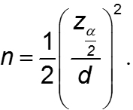
Determining Sample Sizes (1 of 4)
The procedures for finding the sample size necessary to estimate σ are much more complex than the procedures given earlier for means and proportions. For normally distributed populations, the table on the following slide, or the following formula can be used:

Slide 30
Determining Sample Sizes (2 of 4)
Finding Sample Size
σ
To be 95% confident that s is within … | Of the value of σ, the sample size n should be at least
1% | 19,205
5% | 768
10% | 192
20% | 48
30% | 21
40% | 12
50% | 8

Slide 31
Determining Sample Sizes (3 of 4)
Finding Sample Size
σ
To be 99% confident that s is within … | Of the value of σ, the sample size n should be at least
1% | 33,218
5% | 1,338
10% | 336
20% | 85
30% | 38
40% | 22
50% | 14

Slide 32
Determining Sample Sizes (4 of 4)
Statdisk also provides sample sizes. With Statdisk, select Analysis, Sample Size Determination, and then Estimate Standard Deviation. Excel, StatCrunch, and the TI-83/84 Plus calculator do not provide such sample sizes.

Slide 33
Example: Finding Sample Size for Estimating σ (1 of 2)
We want to estimate the standard deviation σ of all IQ scores of people with exposure to lead. We want to be 99% confident that our estimate is within 5% of the true value of σ. How large should the sample be? Assume that the population is normally distributed.

Slide 34
Example: Finding Sample Size for Estimating σ (2 of 2)
Solution
From the table given for finding sample size, we can see that 99% confidence and an error of 5% for s correspond to a sample of size 1336. We should obtain a simple random sample of 1336 IQ scores from the population of subjects exposed to lead.

